Slide 1
BLACK HISTORY MONTH
AFRICA AWARENESS WEEK
2025 Black History Month UK theme – “Standing Firm in Power and Pride” and Afrikindness’ Africa Awareness Week model.
Each plan:
Is age-appropriate (progression from simple to complex).
Covers two dimensions: Standing Firm in Power (resilience, leaders, resistance) and Standing Firm in Pride (identity, purpose, creativity, heritage).
Includes learning objectives, activities, discussion prompts and reflection tasks.
Highlights Black and diverse leaders globally and locally (e.g., Mary Seacole, Rosa Parks, Nelson Mandela, Wangari Maathai, Chimamanda Ngozi Adichie).
Embeds values: steadfastness, perseverance, inner strength, vigilance and pride in identity.

Slide 2
BLACK HISTORY MONTH
2025
Lesson Slides by Key Stages
KS1 (Ages 5–7) – Inner Strength & Courage
  Story slides (Rosa Parks, Mary Seacole).
  Activity slides (role play, pride posters).
  Reflection prompt: “I am strong when I…”
KS2 (Ages 7–9) – Perseverance & Identity
  Mandela timeline (visual).
  Wangari Maathai activity: Identity Shield.
  Discussion: “Why do we keep going when things are hard?”
KS2 (Ages 9–11) – Resistance & Conviction
  Extracts of Maya Angelou’s Still I Rise.
  Harriet Tubman & Marcus Rashford slides.
  Poetry writing frame.
KS3 (Ages 11–13) – Vigilance & Steadfastness
  MLK vs Malcolm X comparison chart.
  Claudia Jones and Carnival slides.
  Debate activity: “What do you stand firm for?”
KS4 (Ages 14–16) – Purpose & Perseverance
  Angela Davis & Mandela profiles.
  Speech analysis template.
  Group project guide: campaign poster/video.
KS5 (Ages 16–18) – Identity & Pride
  Chimamanda Ngozi Adichie: Danger of a Single Story.
  Baldwin/Obama comparative analysis.
  Creative showcase guide (poetry, film, art).

Slide 3
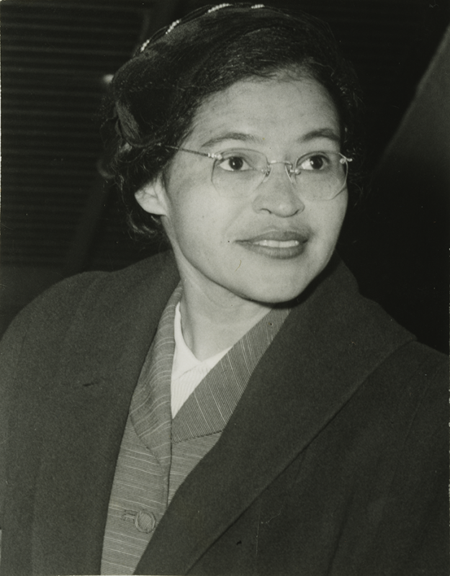
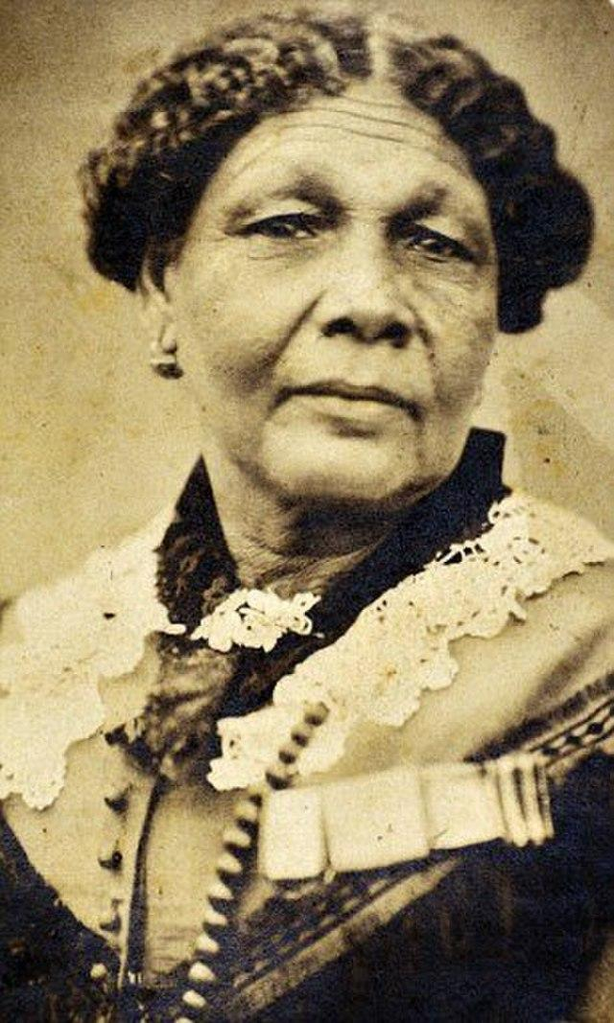
BLACK HISTORY MONTH
2025
Inner Strength and Courage
Key Stage 1
(Ages 5–7)
Learning Objectives:
Understand what it means to “Stand Firm” through stories of bravery.
Recognise that everyone has inner strength.
Celebrate role models who showed courage.
Activities:
Storytelling Circle – Read a simplified story of Rosa Parks refusing to give up her seat. Discuss: “What does it mean to be brave even when it’s hard?”
Role Play – Children act out small moments of “Standing Firm” (e.g., saying no to unfairness, helping a friend).
Pride Poster – Each child draws a “Pride Portrait” of themselves standing strong like Rosa or Mary.
Success Criteria:
Understand what it means to “Stand Firm” through stories of bravery.
Recognise that everyone has inner strength.
Celebrate role models who showed courage.
Rosa Parks (1913–2005)
Key Figures:
Rosa Parks, Mary Seacole.
Keywords:
Brave, Fair, Strong, Proud, Courage
Cross-Curricular Links:
History – Significant individuals (Rosa Parks, Mary Seacole). PSHE – Self-identity, Fairness, Respect. Art – Pride Posters.
Reflection:
One thing I can do to show strength is…
One thing I am proud of is…
Mary Seacole (1805 - 1881)

Slide 4
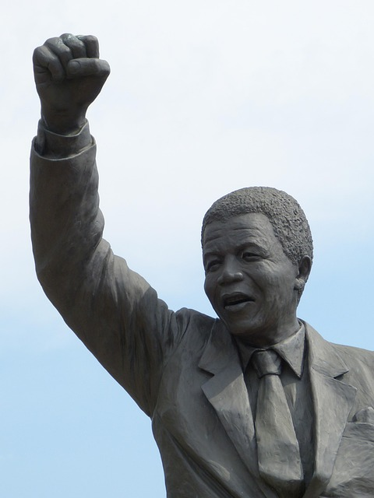
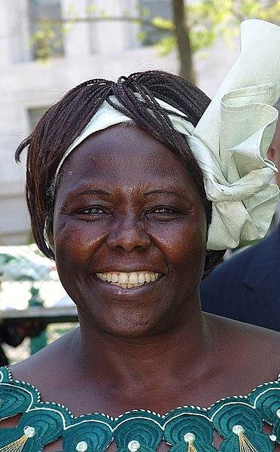
BLACK HISTORY MONTH
2025
Perseverance and Identity
Key Stage 2
(Ages 7–9)
Learning Objectives:
Explore how leaders kept going despite challenges.
Understand the meaning of identity and pride in who we are.
Link perseverance to personal goals.
Activities:
Timeline of Resilience – Mandela’s years in prison → freedom → presidency. Pupils build a visual timeline with key moments of “Standing Firm.”
Identity Shields – Inspired by Wangari Maathai’s tree planting, students design shields with symbols of their identity and what gives them strength.
Group Discussion – “Why is it important not to give up when things are difficult?”
Success Criteria:
I can describe what perseverance means.
I can explain how Mandela or Maathai showed strength.
I can design an identity shield to show my pride..
Nelson Mandela
Key Figures:
Nelson Mandela, Wangari Maathai (Kenyan environmentalist & Nobel Prize winner)
Keywords:
Perseverance, Identity, Leader, Strength, Freedom.
Cross-Curricular Links:
History – Biographies of significant figures.
PSHE – Resilience, identity. Art – Identity Shield.
English – Storytelling and reflection writing.
Reflection:
Write one sentence: “I can stand firm by…”
Wangari Maathai

Slide 5
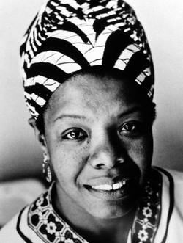
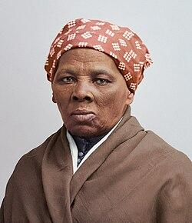
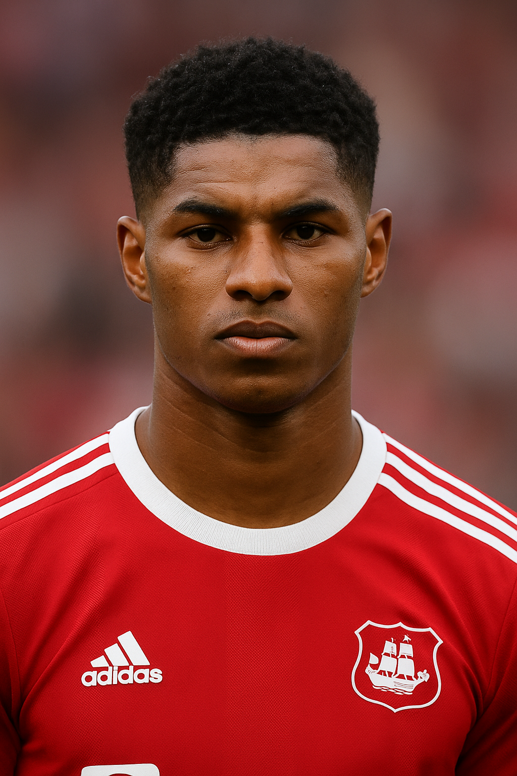
BLACK HISTORY MONTH
2025
Resistance and Conviction
Key Stage 2
(Ages 9–11)
Learning Objectives:
Explore how resistance can be peaceful and powerful.
Analyse the conviction behind leaders’ actions.
Connect pride with cultural heritage.
Activities:
Poetry Exploration – Maya Angelou’s “Still I Rise” (child-friendly extracts). Pupils write their own short “I Rise” verse.
Debate Role Play – Groups take roles of Harriet Tubman, Marcus Rashford, and a community leader. Discuss: “What do you stand firm for?”
Pride in Heritage Map – Students research one aspect of African or Caribbean culture to present.
Success Criteria:
I can explain how Maya Angelou, Marcus Rashford, or Harriet Tubman stood firm.
I can write a verse showing how I “stand firm.”
I can research and share about my heritage or culture.
Maya Angelou
Key Figures:
Maya Angelou, Harriet Tubman, Marcus Rashford
Harriet Tubman
Keywords:
Resistance, Conviction, Pride, Culture, Heritage.
Cross-Curricular Links:
English – Poetry (Still I Rise). PSHE – Identity, Values, Resilience. History – Civil Rights Movement.
Geography – Mapping heritage connections.
Reflection:
“The strength I admire most is…”
Marcus Rashford

Slide 6
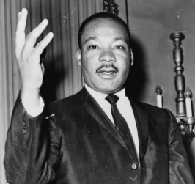
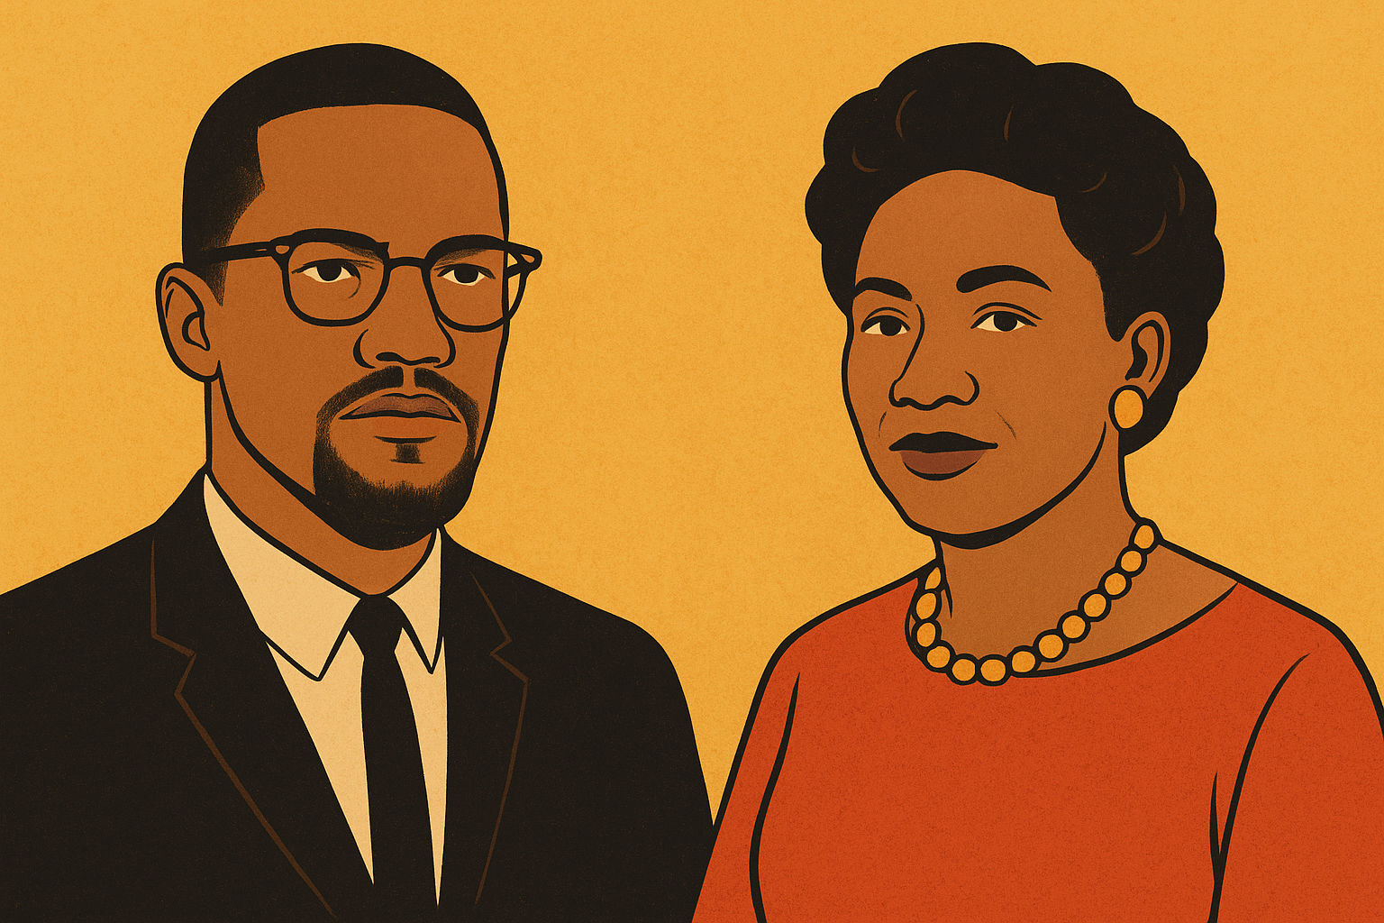
BLACK HISTORY MONTH
2025
Vigilance and Steadfastness
Key Stage 3
(Ages 11 - 13)
Learning Objectives:
Understand vigilance as “keeping watch” for justice.
Study how communities unite in resistance.
Explore how Black leaders shaped global movements
Activities:
Case Study – MLK’s “I Have a Dream” vs Malcolm X’s call for dignity. Compare different ways of “standing firm.”
Cultural Celebration Workshop – Claudia Jones and the origins of Carnival → pupils design a “Celebration of Pride” banner.
Discussion – What does vigilance look like in school or community life?
Success Criteria:
I can compare MLK’s and Malcolm X’s approaches.
I can explain how Claudia Jones used culture to show pride.
I can create a “Celebration of Pride” banner
Martin Luther King Jr.
Key Figures:
Martin Luther King Jr.(MLK), Malcolm X,
Claudia Jones (founder of Notting Hill Carnival)
Malcolm X
Keywords:
Vigilance, Steadfast, Resistance, Conviction, Community.
Cross-Curricular Links:
History – Civil Rights & Black British history.
PSHE – Social justice, equality. Art/Design – Carnival banners. English – Speech and debate skills.
Reflection:
Journal entry:
“If I saw injustice, I would stand firm by…”
Claudia Jones

Slide 7
BLACK HISTORY MONTH
2025
Perseverance, Resistance and Purpose
Key Stage 4
Learning Objectives:
Analyse historical and contemporary examples of perseverance.
Discuss how purpose sustains resistance movements.
Reflect on personal and collective responsibility for justice.
Activities:
Speech Analysis – Excerpts from Angela Davis and Adichie. Students annotate for themes of pride, conviction, and resistance.
Group Project – Create a campaign poster/video on a modern issue (equality, climate justice, education access).
Debate – “Is standing firm always peaceful?”
Success Criteria:
I can analyse key speeches for themes of power and pride.
I can explain how leaders like Angela and Mandela stood firm.
I can work with my peers to create a campaign on a modern issue.
Key Figures:
Nelson Mandela, Angela Davis, Kwame Nkrumah, Chimamanda Ngozi Adichie.
Keywords:
Perseverance, Purpose, Resistance, Activism, Equality.
Cross-Curricular Links:
History – Civil Rights & Black British history. English – Speech analysis, persuasive writing. History – Decolonisation, Civil Rights, Apartheid. PSHE – Citizenship, activism, values.
Reflection:
“The purpose that keeps me steady is…”

Slide 8
BLACK HISTORY MONTH
2025
Identity, Pride and Global Narratives
Key Stage 5
Learning Objectives:
Critically examine how narratives of Black history shape identity.
Explore how pride empowers individuals and communities.
Analyse literature, art and speeches as expressions of standing firm.
Activities:
Text Study – Adichie’s “The Danger of a Single Story.” Discussion: How do stories shape identity and pride?
Comparative Analysis – James Baldwin and Obama on racial identity and leadership.
Creative Showcase – Students create poetry, short film, or artwork exploring their own “Standing Firm” journey.
Success Criteria:
I can analyse texts by Adichie, Baldwin and Obama.
I can create a piece of writing, art or media that reflects my own “standing firm” story.
I can compare how different figures stand firm in power and pride.
Key Figures:
Chimamanda Ngozi Adichie, James Baldwin, W.E.B. Du Bois, Barack Obama, Ngozi Okonjo-Iweala.
Keywords:
Identity, Narrative, Resilience, Pride, Conviction.
Cross-Curricular Links:
English/Literature – Text study (Adichie, Baldwin). History – Global Black leaders. Art/Media – Creative showcase projects.
PSHE/Citizenship – Diversity, identity, empowerment.
Reflection:
Essay: “How can identity and pride be sources of strength in facing today’s challenges?”

