Slide 1

Black History Month 2025
Afrikindness - Africa Awareness Week
KS2 Lesson Plan
Theme: Standing Firm in Power and Pride Duration: 60 minutes

Slide 2
KS2 Lesson Plan
Learning Objectives
Understand the meaning of "Standing Firm in Power and Pride.”
Explore the lives of Black leaders who showed resilience and inner strength.
Reflect on how perseverance, identity, and purpose help us stand firm today.
Create a group response (poster, diary entry, or role-play) showcasing understanding.

Slide 3

KS2 Lesson Plan
Keywords:
Resilience – trying again after difficulty
Steadfastness – being steady and strong
Identity – who you are, your culture and values
Pride – feeling confident and valued in yourself
Conviction – standing firm in your beliefs
Success Criteria:
I can explain what it means to “stand firm.”
I can describe how at least one Black leader stood firm in power.
I can describe how at least one Black leader stood firm in pride.
I can apply these ideas to my own life in a creative activity.
Starter Activity (5 minutes)
Show images of Nelson Mandela, Mary Seacole, and Chimamanda Ngozi Adichie.
Ask: Who are they? What do you think they might have stood for?
Discuss how each person might have shown power and pride

Slide 4

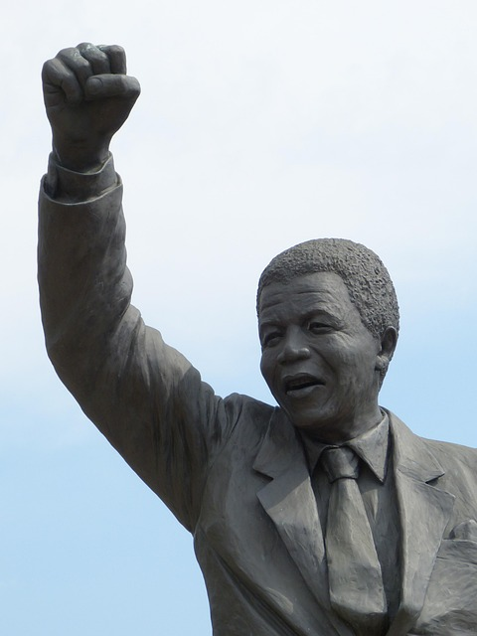
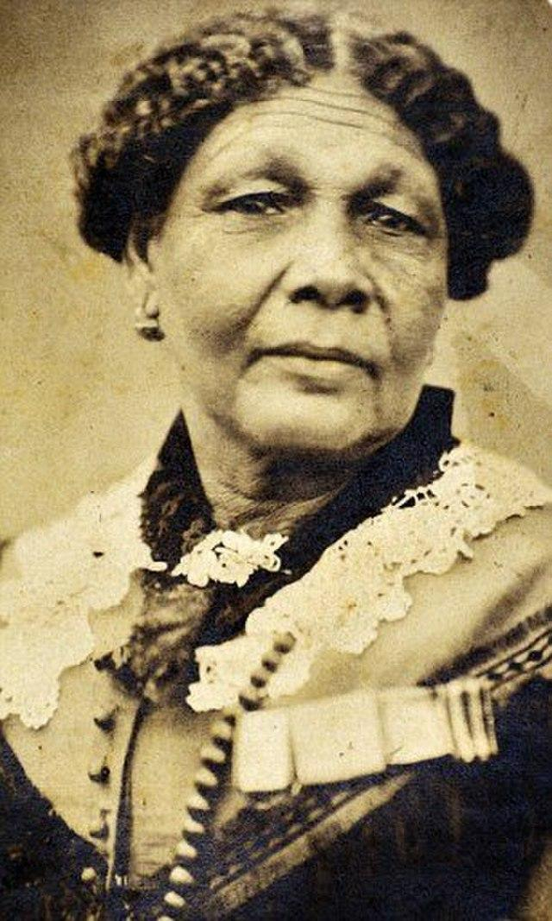
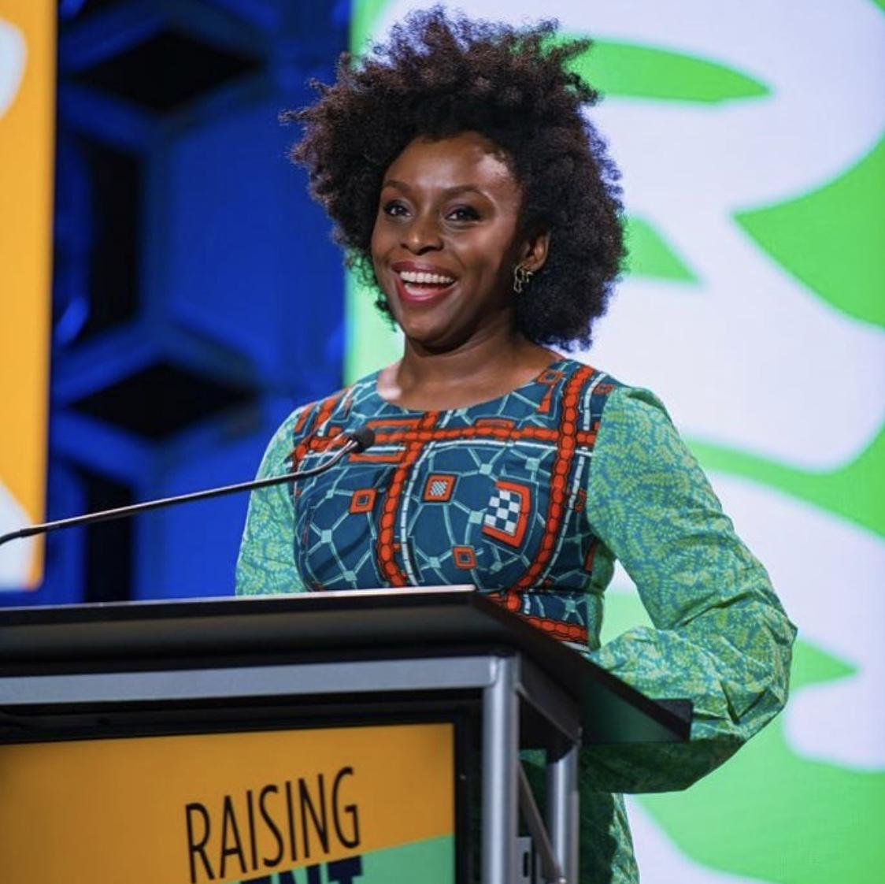
KS2 Lesson Plan
Main Input (20 minutes)
Storytelling
Share Mandela’s story of resilience and prison life.
Share Mary Seacole’s story of determination to help soldiers despite rejection.
Standing Firm in Pride
Play a short clip from Chimamanda Ngozi Adichie’s TED talk: The Danger of a Single Story.
Discuss why it is important to be proud of one’s identity and story.
3. Themes Discussion
Steadfastness = never giving up (Mandela).
Resistance & conviction = fighting for justice (Mary Seacole’s persistence).
Identity & pride = celebrating who you are (Adichie).

Slide 5

KS2 Lesson Plan
Group Activity (20 minutes):
Split into groups:
Mandela Group: Create a poster about resilience.
Seacole Group: Write a diary entry imagining her voice.
Adichie Group: Design a “single story” comic showing pride in identity.
Differentiation:
Provide sentence starters for less confident writers. Encourage drawing for EAL students.

Slide 6
KS2 Lesson Plan
Reflection / Plenary (10 minutes)
Think-Pair-Share: How can we stand firm in our own lives?
Exit ticket: Write one word about what “Standing Firm” means to you.
Cross-Curricular Links
English: Writing diary entries, speeches, or poetry. History: Exploring timelines of Black leaders. PSHE: Resilience, confidence, and equality. Art: Posters or drawings of “Standing Firm.”
Teacher Notes (Guidance)
Keep explanations age-appropriate.
Use simple analogies (resilience = practising football until you score).
Encourage respectful discussion about fairness, justice, and identity.
Pause video clips for reflection questions.
Allow creative responses – not all need to be written.

Slide 7
KS2 Lesson Plan
Standing Firm in Power: Key Leaders
Nelson Mandela – fought against apartheid, showed resilience in prison
Mary Seacole – a nurse who helped soldiers during the Crimean War despite prejudice
Activity: Create a timeline or a short fact file of their achievements.
Standing Firm in Pride: Global Figures
Chimamanda Ngozi Adichie – A Nigerian author who speaks about identity and culture
Watch short clip: ‘The Danger of a Single Story’ (TED Talk)

Slide 8
End Quote
"I am no longer accepting the things I cannot change. I am changing the things I cannot accept." – Angela Davis
Discussion Prompt: How can we use this idea in our own lives?

Slide 9

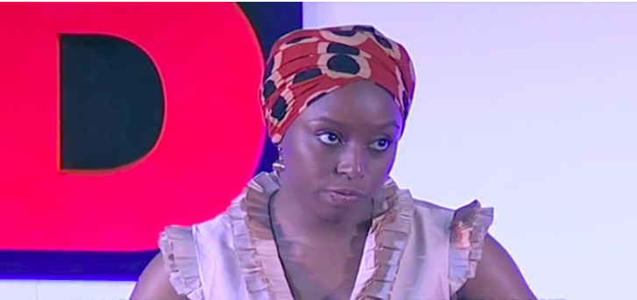

KS2 Lesson Plan
Suggested Resources / Links
https://www.bbc.co.uk/teach/black-history-month-primary-and-secondary-resources/zjwf8xs
https://www.ted.com/talks/chimamanda_ngozi_adichie_the_danger_of_a_single_story
https://www.bbc.co.uk/bitesize/topics/zjkj382/articles/zknmrj6

