Slide 1

Black History Month 2025
Afrikindness - Africa Awareness Week
KS3 Lesson Plan
Theme: Standing Firm in Power and Pride Duration: 45 minutes

Slide 2
KS3 Lesson Plan
Learning Objectives
Understand what it means to stand firm in power and pride.
Explore key Black leaders and their resilience.
Reflect on how identity and pride empower individuals.
Keywords
Resilience, Conviction, Pride, Identity, Empowerment

Slide 3
KS3 Lesson Plan
Success Criteria:
By the end of this lesson:
I can define the theme Standing Firm in Power and Pride.
I can give examples of leaders who embodied resilience.
I can explain why these lessons are relevant today.
Cross-Curricular Links
English – speech and text analysis. History – civil rights and activism Citizenship/PSHE – identity, justice, community.
Art – poster or visual project
Teacher Notes (Guidance)
Use quotes to spark critical thinking.
Encourage respectful discussion around debates.
Adapt activities to group size and ability.

Slide 4

KS3 Lesson Plan
Starter:- Quotes Carousel. Project the following quotes …
Ask students: “Who do you think said this?” Give students a couple of minutes to discuss with a partner, or in small groups, what each quote means to them.
“I am no longer accepting the things I cannot change. I am changing the things I cannot accept.”
(Angela Davis)
“A man who stands for nothing will fall for anything.”
(Malcolm X)
“The single story creates stereotypes… and the problem with stereotypes is not that they are untrue, but that they are incomplete.”
(Chimamanda Adichie)
“The generation that destroys the environment is not the generation that pays the price. That is the problem.”
(Wangari Maathai)

Slide 5

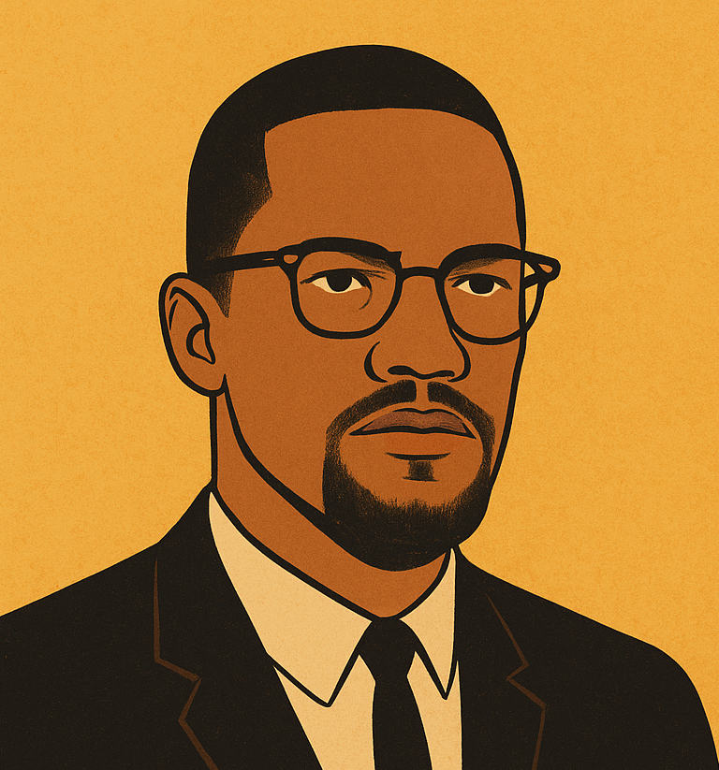
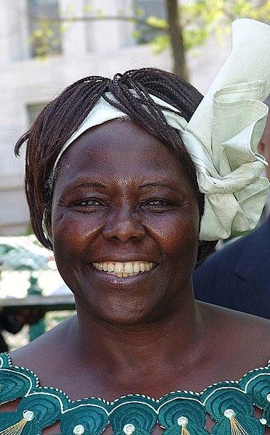
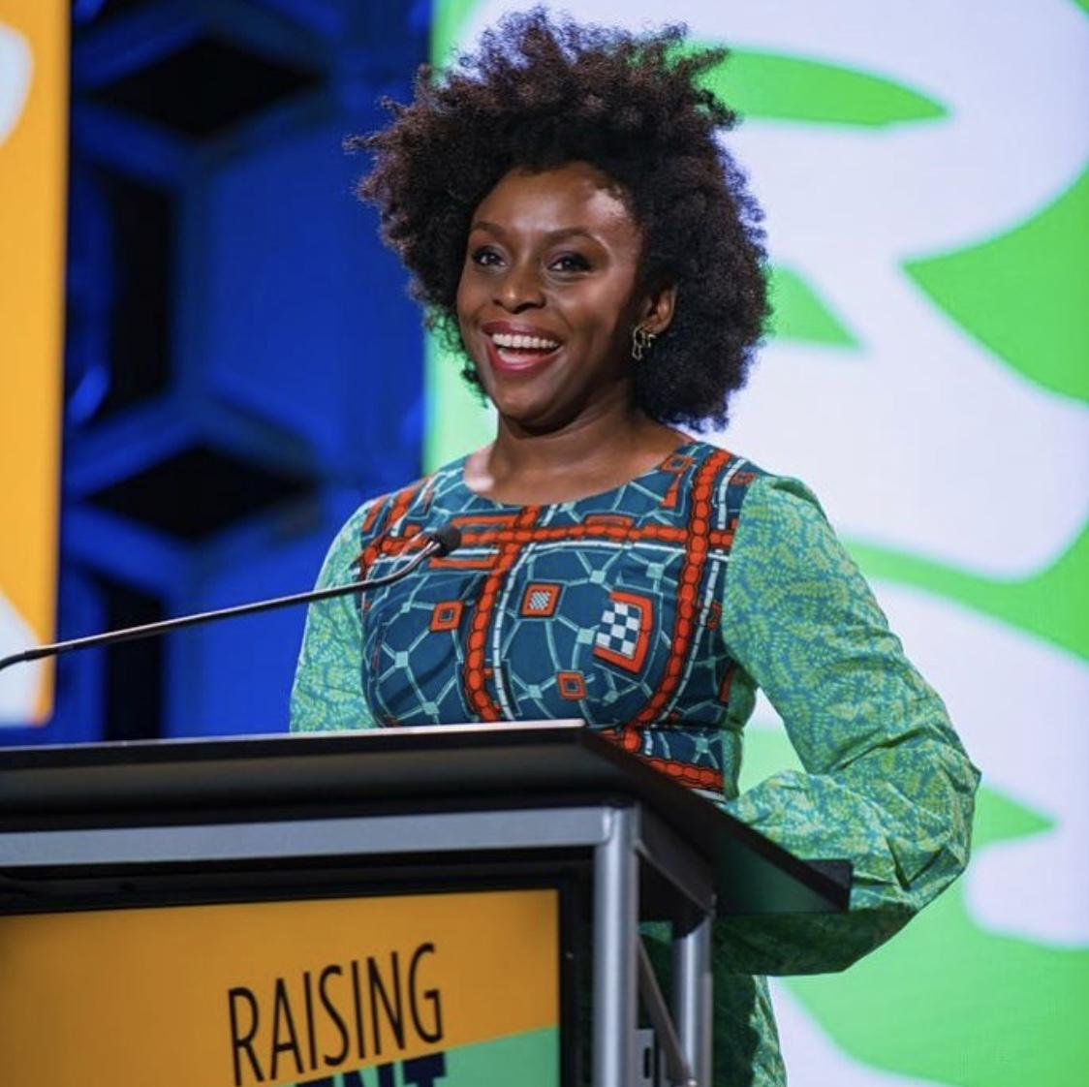
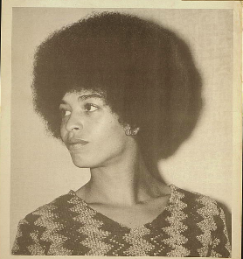
KS3 Lesson Plan
Case Studies: Leaders Who Stood Firm
Angela Davis – conviction, justice, activism
Malcolm X – empowerment, identity, vigilance
Wangari Maathai – perseverance, environmental activism
Chimamanda Ngozi Adichie – storytelling, pride in identity

Slide 6

KS3 Lesson Plan
Group Activity:
Discussion Themes:
Steadfastness and Resistance
Readiness and Vigilance
Perseverance and Inner Strength
Purpose and Identity
Teacher Note: Encourage students to link these qualities to the leaders above.

Slide 7
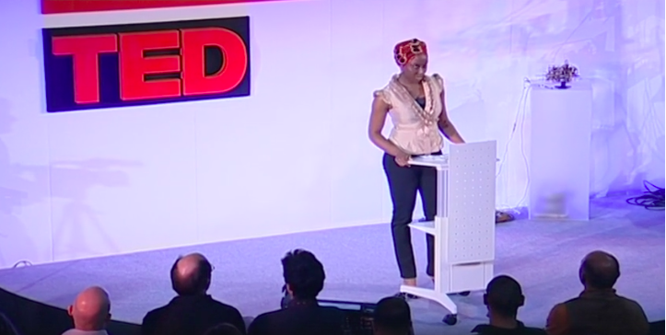
KS3 Lesson Plan
Video: Chimamanda Ngozi Adichie – The Danger of a Single Story
https://www.ted.com/talks/chimamanda_adichie_the_danger_of_a_single_story
Discussion: How does Adichie show pride in her identity through storytelling?

Slide 8
KS3 Lesson Plan
Group Activity
Option 1: Debate
“Is it more important to stand firm in power or in pride?”
Option 2: Creative Task
Poster/Presentation – “How my chosen leader stood firm…”
Reflection / Plenary
How can young people today stand firm in:
Their school
Their community
Their future?

Slide 9
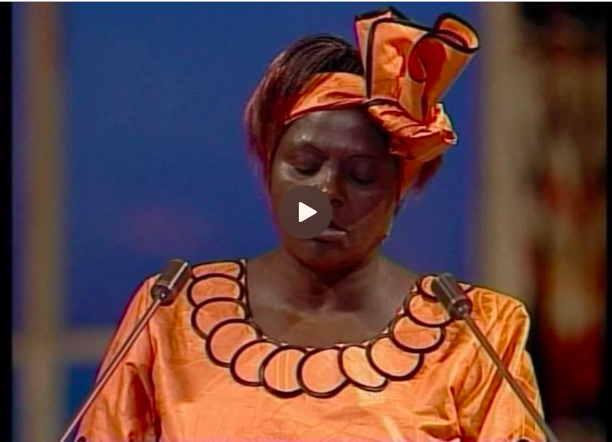
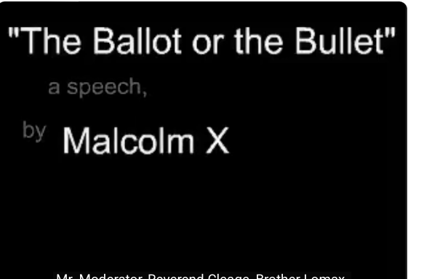
KS3 Lesson Plan
Suggested Resources:
https://www.nobelprize.org/prizes/peace/2004/maathai/lecture/
https://www.youtube.com/watch?v=CRNciryImqg

