Slide 1

Black History Month 2025
Afrikindness - Africa Awareness Week
KS4 Lesson Plan
Theme: Standing Firm in Power and Pride Duration: 45 minutes

Slide 2
KS4 Lesson Plan
Learning Objectives
Critically evaluate the theme Standing Firm in Power and Pride.
Analyse historical and contemporary figures who embody resilience.
Connect Black history to current debates on justice, identity, and activism.
Explore what it means for young people to embody these values today.
Keywords
Resilience, Resistance, Empowerment, Conviction, Identity, Justice, Liberation

Slide 3
KS4 Lesson Plan
Success Criteria:
By the end of this lesson:
I can critically define the theme Standing Firm in Power and Pride.
I can analyse the role of leaders in shaping Black history.
I can evaluate how lessons from history apply to contemporary issues.
Cross-Curricular Links
English Literature/Language – analysing rhetoric, speeches, and storytelling. History – civil rights, postcolonial movements, Black British history. Citizenship/Politics – activism, justice, democracy, inequality. Religious Education (RE) – faith, ethics, and liberation theology. Art & Media – protest art, campaign posters, music as resistance
Teacher Notes (Guidance)
Ensure students engage with both historical and modern voices.
Highlight UK connections (e.g., Claudia Jones, Windrush generation, Black British activism).
Adapt debate tasks to ability level – scaffold arguments if needed.

Slide 4

KS4 Lesson Plan
Starter:- Visual Prompt
Show a powerful image
(e.g., Malcolm X speaking, Angela Davis at a rally, Marcus Rashford campaigning).
Ask: “What messages of power and pride do you see in this image?”

Slide 5

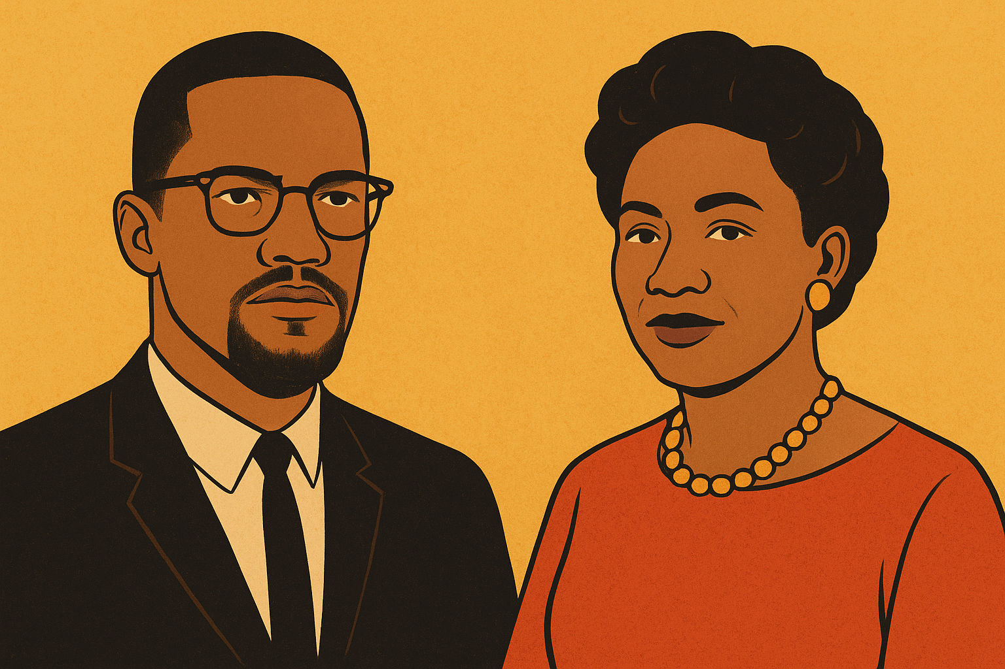
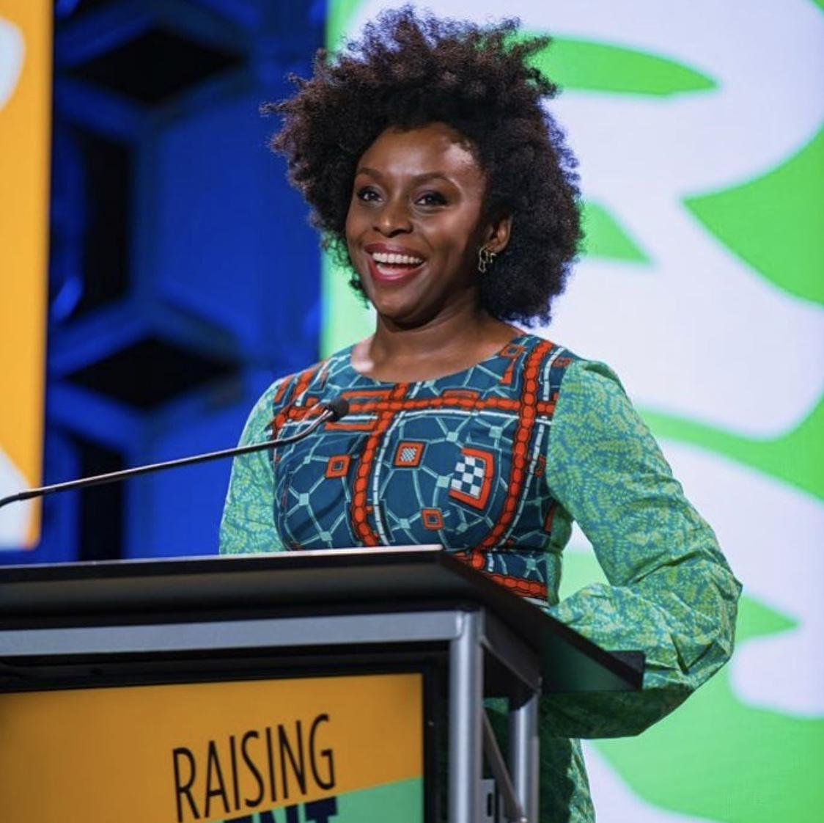
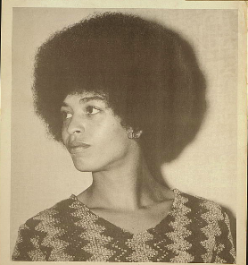
KS4 Lesson Plan
Case Studies: Leaders Who Stood Firm
Malcolm X – radical empowerment, identity, resistance
Angela Davis – conviction, prison abolition, women’s rights
Claudia Jones – activism, founder of Notting Hill Carnival
Chimamanda Ngozi Adichie – cultural pride, decolonising narratives

Slide 6

KS4 Lesson Plan
Group Activity:
Discussion Themes
Steadfastness and Resistance – refusing to yield to oppression
Readiness and Vigilance – awareness of injustice and standing guard
Perseverance and Inner Strength – endurance in the face of setbacks
Purpose and Identity – embracing culture, heritage, and self-definition
Teacher Note: Encourage students to link these qualities to the leaders above.

Slide 7
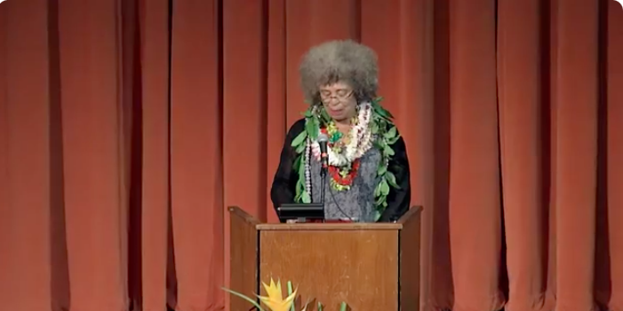
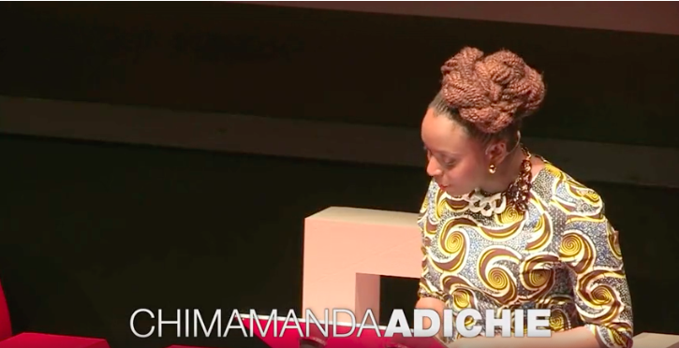
KS4 Lesson Plan
Group Activity: Video and Media Resource
Angela Davis: Freedom Is a Constant Struggle
Start around 00:30 – 06:30 (introduction and framing of “freedom as struggle”) Then optionally another excerpt from ~20:00 – 25:00, where she explores the interconnectedness of social justice struggles (race, gender, prison, etc.).
Chimamanda Ngozi Adichie – We Should All Be Feminists
https://www.ted.com/talks/chimamanda_ngozi_adichie_we_should_all_be_feminists
https://youtu.be/pPasIZ-TAZc?si=Rm0XbVJWg-jT9ney
Discussion: How do these leaders show resilience and pride in their convictions?

Slide 8
KS4 Lesson Plan
Critical Thinking Task
Task: Students analyse a speech (excerpt) from Malcolm X, Angela Davis, or Adichie.
Questions:
What language shows conviction or resistance?
How do they inspire empowerment in others?
Are their messages still relevant today? Why?
Reflection / Plenary
What does it mean for YOU to stand firm in power and pride? Students write a short manifesto: “I will stand firm in…”

Slide 9
KS4 Lesson Plan
Group Activity
Option 1: Structured Debate “True power comes from unity, not resistance.” Discuss.
Option 2: Creative Task Design a campaign (poster, video concept, speech) to inspire young people to “stand firm” in 2025.

Slide 10
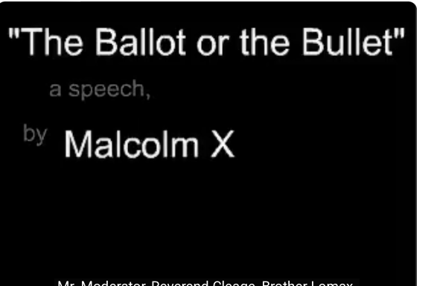
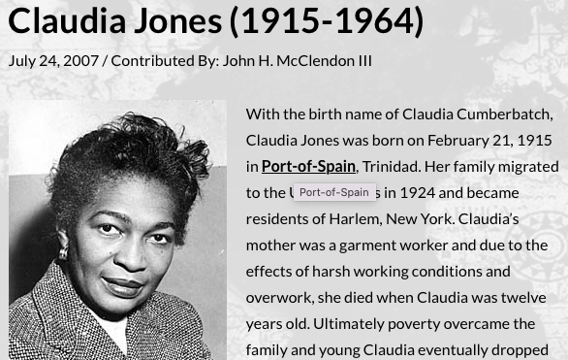
KS4 Lesson Plan
Suggested Resources:
Malcolm X
https://blackpast.org/african-american-history/jones-claudia-1915-1964/
https://www.youtube.com/watch?v=CRNciryImqg

