Slide 1
BLACK HISTORY MONTH
AFRICA AWARENESS WEEK
2025 Black History Month UK theme – “Standing Firm in Power and Pride” and Afrikindness’ Africa Awareness Week model.
Each plan:
Includes learning objectives, activities, discussion prompts and reflection tasks.
Highlights African leaders
Embeds values: courage, steadfastness, perseverance, inner strength, vigilance and pride in identity.

Slide 2
BLACK HISTORY MONTH
2025
Lesson Slides by African Leaders
Madame Nwanyeruwa —
Courage that Sparked Change
Leymah Gbowee –
The Peacebuilder of Liberia
Alaa Salah –
The Woman in White
Funmilayo Ransome-Kuti –
The Lioness of Lisabi
Lilian Ngoyi –
The Mother of the Black Resistance
Anita Barasa –
The Voice of a Generation

Slide 3
BLACK HISTORY MONTH
2025
Madame Nwanyeruwa — Courage that Sparked Change
Learning Objectives:
Understand Nwanyeruwa’s role in the Aba Women’s Riots.
Explore courage and perseverance as tools for justice.
Reflect on how unity creates change.
Lesson Summary (Use as teacher introduction):
In 1929, Madame Nwanyeruwa sparked the Aba Women’s Riots in Nigeria, one of the largest women-led protests against colonial rule. A disagreement with a tax officer ignited a mass uprising as tens of thousands of Igbo women rose to resist unfair policies. Her bold stand turned local grievances into collective action, reshaping the struggle for justice under colonialism. Nwanyeruwa’s courage reminds us that a single act of defiance can grow into a movement that changes the course of history.
Focus Values:
Courage – Standing up for what is right, even when afraid.
Perseverance – Continuing to push forward despite resistance.
Community and Identity – Recognising strength in unity and shared purpose.
Story and Discussion (10–15 minutes)
Read aloud or summarise Madame Nwanyeruwa’s story.
Discuss:
        What made her courageous?
        How did she show perseverance?
        What was the power of unity in her story?
        What lessons can we learn from her leadership?
Encourage students to highlight words that show her inner strength (e.g., courage, justice, unity).
Reflection and Connection (10 minutes)
Prompt students with reflection questions:
What does courage look like in your daily life?
When have you seen or shown perseverance?
How can we support others when they stand for what’s right?
Students write a short paragraph or draw a symbol representing “strength through unity.”
Educational Summary: Madame Nwanyeruwa’s Legacy
Madame Nwanyeruwa and the women of Oloko village inspired other women across Nigeria to take action and form their own political movements. Her leadership during the Aba Women’s War became a turning point in Nigeria’s history — helping to spark early efforts toward African self-rule and equality. Her bravery not only advanced women’s rights but also contributed to the growing movement for Nigeria’s independence, which was achieved in 1960. Nwanyeruwa’s actions remind us that courage and unity can shape a nation’s future.
“Like Madame Nwanyeruwa, we all have the power to spark change — through courage, persistence, and unity.”

Slide 4
BLACK HISTORY MONTH
2025
Funmilayo Ransome-Kuti – The Lioness of Lisabi
Learning Objectives:
Understand the significance of Funmilayo Ransome-Kuti’s leadership in Nigerian history.
Identify values of courage, justice, and equality in her actions.
Reflect on how individual voices can inspire societal change.
Lesson Summary (Use as teacher introduction):
In 1946, Funmilayo Ransome-Kuti led the Abeokuta Women’s Revolt in Nigeria, mobilising thousands to challenge colonial taxation and injustice. Called the “Lioness of Lisabi,” she campaigned tirelessly for education, women’s rights, and political representation. Her fearless stand against both colonial and patriarchal systems made her one of Nigeria’s most influential leaders. Funmilayo’s legacy lives on as a symbol of justice, courage, and the enduring fight for equality. Her story reminds us that true leadership begins with speaking truth to power.
Focus Values:
✨ Courage: Funmilayo stood fearlessly against injustice, even when it meant challenging powerful colonial rulers.
⚖️ Justice: She fought for fair treatment and equal rights for women, believing that everyone deserves a voice.
💬 Advocacy: Funmilayo used her words and actions to speak up for those who could not speak for themselves.
📚 Education: She championed learning as a tool for empowerment and progress, encouraging women and children to seek knowledge.
Story and Discussion (10–15 minutes)
Read aloud or summarise Funmilayo Ransome-Kuti’s story.
Discuss:
What inspired Funmilayo to lead women against unfair taxation?
How did she challenge both colonial rule and gender inequality?
What does “speaking truth to power” mean in today’s world?
Encourage students to highlight words that show her inner strength (e.g., courage, justice, unity).
Reflection and Connection (10 minutes)
Prompt students with reflection questions:
Think about a time when you stood up for what was right.
How can students today use their voices to promote fairness and equality in school or community?
Students write a short paragraph or create a drawing that represents “strength through unity,” inspired by Funmilayo Ransome-Kuti’s leadership and her ability to bring women together to create change.
Educational Summary: Funmilayo Ransome-Kuti’s Legacy
Funmilayo Ransome-Kuti’s leadership reshaped the fight for women’s rights and justice in Nigeria. She showed that true strength lies in standing up for others, paving the way for future generations of women leaders across Africa.
“I do not fear to speak my mind. I will not be silenced.”

Slide 5
BLACK HISTORY MONTH
2025
Lilian Ngoyi – The Mother of the Black Resistance
Learning Objectives:
Lesson Summary (Use as teacher introduction):
In 1956, Lilian Ngoyi stood among the leaders of the great Women’s March to Pretoria, where 20,000 women protested apartheid pass laws in South Africa. Known as the “Mother of the Black Resistance,” she was also the first woman elected to the ANC’s National Executive Committee. Lilian’s fearless defiance embodies the spirit of the struggle against injustice and inspires generations to stand up for equality and rights.
Describe Lilian Ngoyi’s contributions to the anti-apartheid movement.
Explain the significance of the 1956 Women’s March to Pretoria.
Identify the qualities of courage, leadership, and resilience demonstrated by Lilian Ngoyi.
Reflect on how individual and collective action can create social change.
Story and Discussion (10–15 minutes)
Lilian Ngoyi was a trailblazer in the fight against apartheid in South Africa. In 1956, she joined other women leaders to organize a march to Pretoria to protest the oppressive pass laws that restricted the movement of Black South Africans. Despite facing arrest and intimidation, Lilian continued to lead, becoming the first woman elected to the ANC’s National Executive Committee.
Discussion Questions:
What challenges did Lilian Ngoyi face, and how did she overcome them?
How did working together with others strengthen the women’s cause?
In what ways can we apply Lilian Ngoyi’s courage and leadership in our own lives?
Reflection and Connection (10 minutes)
Prompt students with reflection questions:
Think about a time when you stood up for what was right.
Students can write a short paragraph, create a drawing, or share a story showing how they can stand up for fairness and equality in their own communities. Encourage them to think about ways their voice or actions could contribute to positive change.
Focus Values:
Courage – standing up to unfair laws, even when it put her at risk.
Unity –She brought together thousands of women, proving that strength comes from working as one.
Leadership –As the first woman elected to the ANC’s National Executive, she led by example & inspired others
Perseverance – Despite arrests and intimidation, Lilian never gave up on the fight for justice and equality.
Educational Summary: Lilian Ngoyi’s Legacy
Lilian Ngoyi’s life teaches us that women’s voices and actions are powerful tools for change. Through courage, unity, and persistence, she not only challenged apartheid laws but also paved the way for future generations of leaders. Her legacy reminds students that standing up for justice requires determination, teamwork, and unwavering belief in equality.
"Do not wait for leaders; do it alone, person to person." – Lilian Ngoyi

Slide 6
BLACK HISTORY MONTH
2025
Leymah Gbowee – The Peacebuilder of Liberia
Learning Objectives:
Lesson Summary (Use as teacher introduction):
In 2003, Leymah Gbowee led Liberia’s women in a powerful non-violent movement to end the civil war. Uniting across faith and ethnicity, they prayed, protested, and demanded peace, forcing leaders to the negotiating table. Their persistence changed the course of Liberia’s history, paving the way for Africa’s first female president.
Leymah’s story reminds us that women’s collective strength can break cycles of violence and rebuild nations.
Explain Leymah Gbowee’s role in the peace movement in Liberia.
Describe how unity and non-violent action can influence political change.
Identify the qualities of leadership, courage, and perseverance demonstrated by Leymah Gbowee.
Reflect on how collaboration and faith can help communities resolve conflicts
Story and Discussion (10–15 minutes) Leymah Gbowee united women of all religions and ethnic groups in Liberia to protest the civil war through prayer, peaceful demonstrations, and advocacy. Their movement forced political leaders to negotiate, ending years of violence. Leymah’s leadership earned her the Nobel Peace Prize and inspired a generation of women to believe in their power to change their country.
Discussion Questions:
How did Leymah Gbowee bring women together despite their differences?
Why is non-violent protest an effective way to demand change?
What can we learn from Leymah’s leadership and courage for solving problems in our own communities?
Reflection and Connection (10 minutes)
Prompt students with reflection questions:
Think about a time when you stood up for what was right.
Students can create a short paragraph, a drawing, or a symbol showing how unity and peaceful action can help solve conflicts. They can reflect on a time when working together with others made a difference.
Focus Values:
Courage: Leymah Gbowee bravely led women to demand peace, even in a war zone.
Unity: She brought women together across faiths and ethnicities to fight for a shared goal.
Leadership: Leymah guided a nation toward peace through her vision and actions.
Perseverance: Despite threats and challenges, she never stopped working for change.
Educational Summary: Leymah Gbowee’s Legacy
Leymah Gbowee’s life shows that courage, unity, and perseverance can overcome violence and injustice. Through her leadership, she proved that women’s collective voice can rebuild nations, foster peace, and inspire future generations.
"I believe that if women can stand up and be counted, they can change the world." – Leymah Gbowee

Slide 7
BLACK HISTORY MONTH
2025
Alaa Salah – The Woman in White
Learning Objectives:
Lesson Summary (Use as teacher introduction):
In 2019, Alaa Salah became a symbol of Sudan’s revolution against decades of dictatorship. Dressed in white and standing on a car, she led chants that echoed across the nation, inspiring thousands. Her bravery went viral, showing the central role of women in movements for freedom and justice. Alaa’s story reminds us that young women can stand at the very heart of history.
Describe Alaa Salah’s role in Sudan’s revolution.
Explain how courage and leadership can influence social and political movements.
Identify the values of bravery, unity, and resilience demonstrated by Alaa Salah.
Reflect on how young people can make a difference in their communities.
Story and Discussion (10–15 minutes)
Alaa Salah stood as a beacon of hope during Sudan’s revolution. Dressed in white, she led chants from atop a car, motivating crowds and gaining worldwide attention. Her courage highlighted the pivotal role of women, especially young women, in shaping history.
Discussion Questions:
What made Alaa Salah’s actions so powerful and symbolic?
How can one person inspire thousands to stand for justice?
How does Alaa’s courage and leadership relate to challenges in our own lives?
Reflection and Connection (10 minutes)
Prompt students with reflection questions:
Think about a time when you stood up for what was right.
Students can write a short paragraph, create a drawing, or share a story about a time they or someone they know stood up for what was right. Encourage them to reflect on how young people can lead positive change.
Focus Values:
Courage: Alaa Salah led chants for justice, showing bravery in front of danger.
Unity: She inspired thousands to stand together for a common cause.
Leadership: Her presence guided and motivated people during Sudan’s revolution.
Resilience: She remained steadfast despite challenges and oppression.
Educational Summary: Alaa Salah’s Legacy
Alaa Salah’s life shows that courage, leadership, and resilience can spark movements that change nations. Her image and actions demonstrate the power of young women to inspire, lead, and shape history.
"We are the revolution. We are the future." – Alaa Salah

Slide 8
BLACK HISTORY MONTH
2025
Anita Barasa – The Voice of a Generation
Learning Objectives:
Lesson Summary (Use as teacher introduction):
In 2024, Anita Barasa’s voice rose during Kenya’s Gen Z protests, where young people united to demand justice and accountability. Through powerful videos that spread rapidly online, she captured the urgency and courage of a new generation unwilling to be silenced. Anita’s creativity and fearless activism showed how digital platforms can mobilise change and amplify voices worldwide. Her story reminds us that young people can inspire hope and transformation even in the face of injustice.
Describe Anita Barasa’s role in Kenya’s Gen Z protests.
Explain how digital platforms can be used to amplify voices and mobilise social change.
Identify the values of courage, creativity, and leadership demonstrated by Anita Barasa.
Reflect on how young people can make a meaningful impact in their communities and beyond.
Story and Discussion (10–15 minutes)
Anita Barasa emerged as a leading voice for Kenya’s Gen Z protests, using social media and video content to highlight injustices and mobilise her peers. Her fearless approach drew attention both locally and globally, proving the power of digital activism in modern movements.
Discussion Questions:
How did Anita use digital platforms to inspire action?
Why is creativity important in activism?
How can young people today make their voices heard in their communities?
Reflection and Connection (10 minutes)
Prompt students with reflection questions:
Think about a time when you stood up for what was right.
Students can create a short paragraph, drawing, or digital project showing how they could use their skills or platforms to advocate for something they care about. Encourage them to consider how even small actions can contribute to change.
Focus Values:
Courage: Anita Barasa spoke out for justice despite potential risks.
Creativity: She used videos and digital media to amplify her message.
Leadership: Anita inspired her peers to join the fight for accountability.
Persistence: She continued advocating for change despite challenges.
Educational Summary: Anita Barasa’s Legacy
Anita Barasa demonstrates that courage, creativity, and leadership can drive social change. By using digital platforms effectively, she showed that young people have the power to challenge injustice, inspire others, and shape a better future.
"Our voices are not just for today; they are the power to shape tomorrow." – Anita Barasa

Slide 9
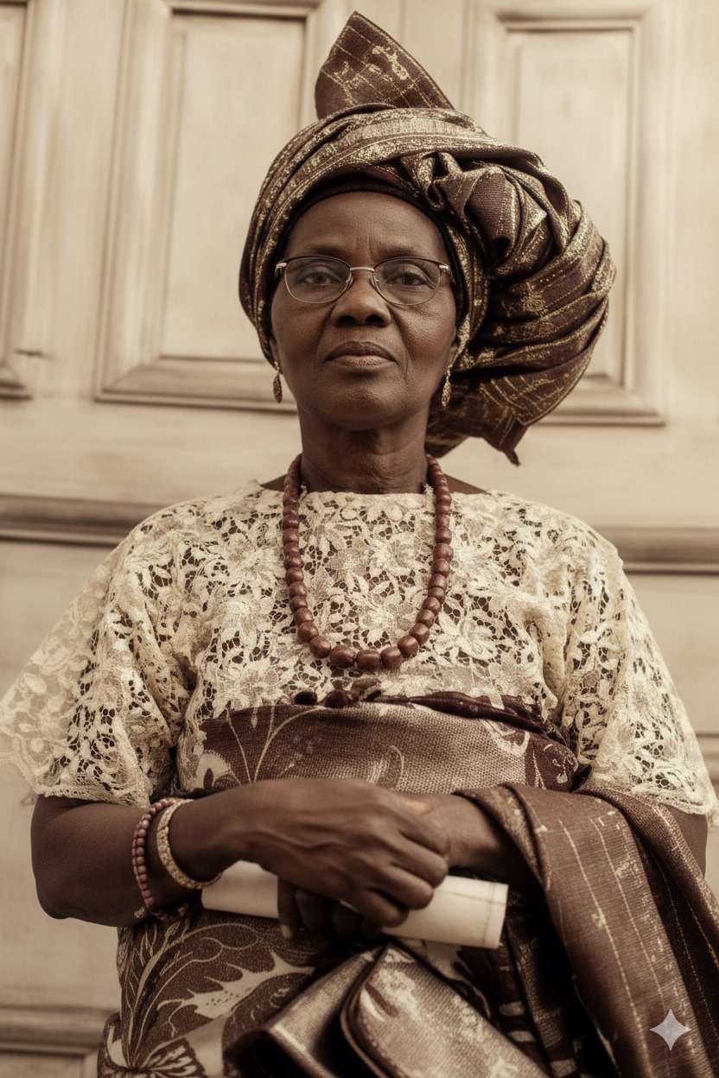
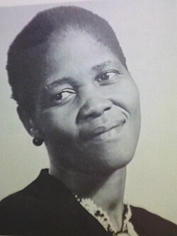
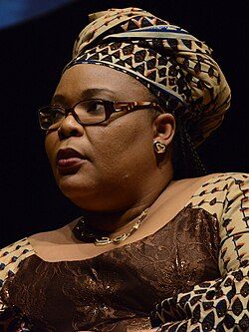
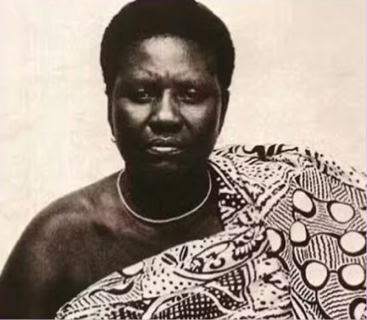
Madame Nwanyeruwa
HistoryLovers/Instagram
Lillian Matabane Ngoyi
(wikepedia)
Leymah Gbowee
(wikepedia)
Funmilayo Ransome-Kuti

